Slide 1

Note: The data and information in this document is reflective of a hypothetical situation and client. This document is to be used for KPMG Virtual Internship purposes only.
Sprocket Central Pty Ltd
Data analytics approach
[Division Name] - [Engagement Manager], [Senior Consultant], [Junior Consultant]

Slide 2
Note: The data and information in this document is reflective of a hypothetical situation and client. This document is to be used for KPMG Virtual Internship purposes only.
Agenda
Introduction
Data Exploration
Model Development
Interpretation

Slide 3
Note: The data and information in this document is reflective of a hypothetical situation and client. This document is to be used for KPMG Virtual Internship purposes only.
Introduction
Transactions Analysis
In 2017, revenue tends to be flat (no change in revenue).
The Solex brand contributes the largest amount of sales and has the largest canceled transaction rate of all brands, but this rate is not high (nearly 1%). WeareA2B brand has the 2nd highest sales and sales are trending up.
Products with the Solex brand, belonging to the Standard product line, medium product class and medium product size contributed the largest sales to the Solex brand.
Of all the products, the product is branded WeareA2B, which belongs to the standard product line, medium product class and medium procduct size has the largest total sales.

Slide 4
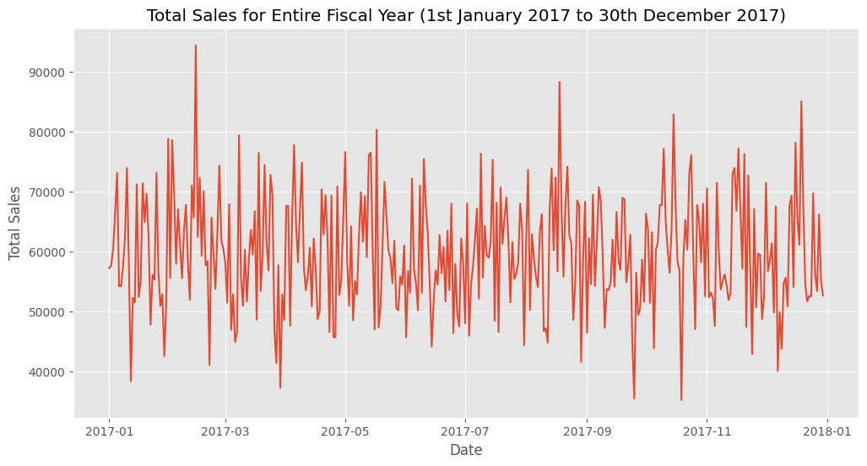
Note: The data and information in this document is reflective of a hypothetical situation and client. This document is to be used for KPMG Virtual Internship purposes only.
Data Exploration
Revenue in 2017
In general, revenue in 2017 fluctuated up and down, but the trend of revenue remained unchanged this year

Slide 5
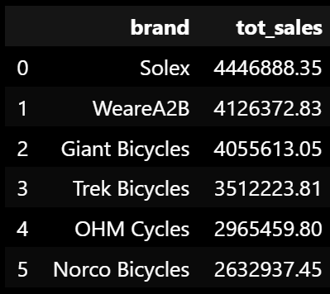
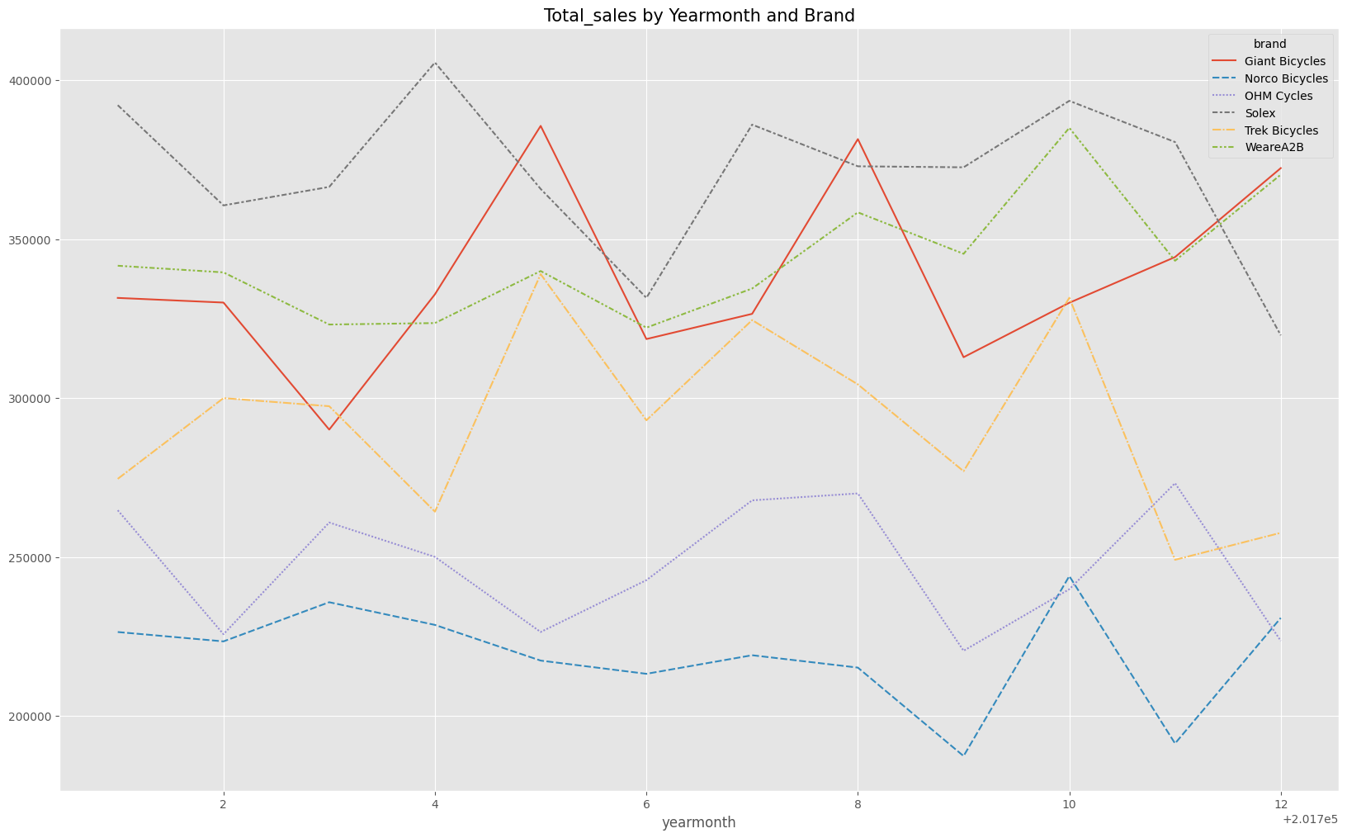
Note: The data and information in this document is reflective of a hypothetical situation and client. This document is to be used for KPMG Virtual Internship purposes only.
Data Exploration
Product brand
The Solex brand contributes the largest amount of sales and has the largest canceled transaction rate of all brands, but this rate is not high (nearly 1%). WeareA2B brand has the 2nd highest sales and sales are trending up.

Slide 6
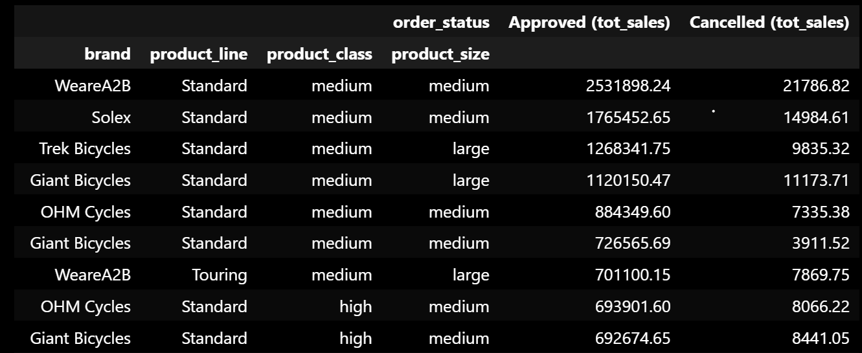
Note: The data and information in this document is reflective of a hypothetical situation and client. This document is to be used for KPMG Virtual Internship purposes only.
Data Exploration
Product
Products with the Solex brand, belonging to the Standard product line, medium product class and medium product size contributed the largest sales to the Solex brand.
Of all the products, the product is branded WeareA2B, which belongs to the standard product line, medium product class and medium procduct size has the largest total sales.

Slide 7
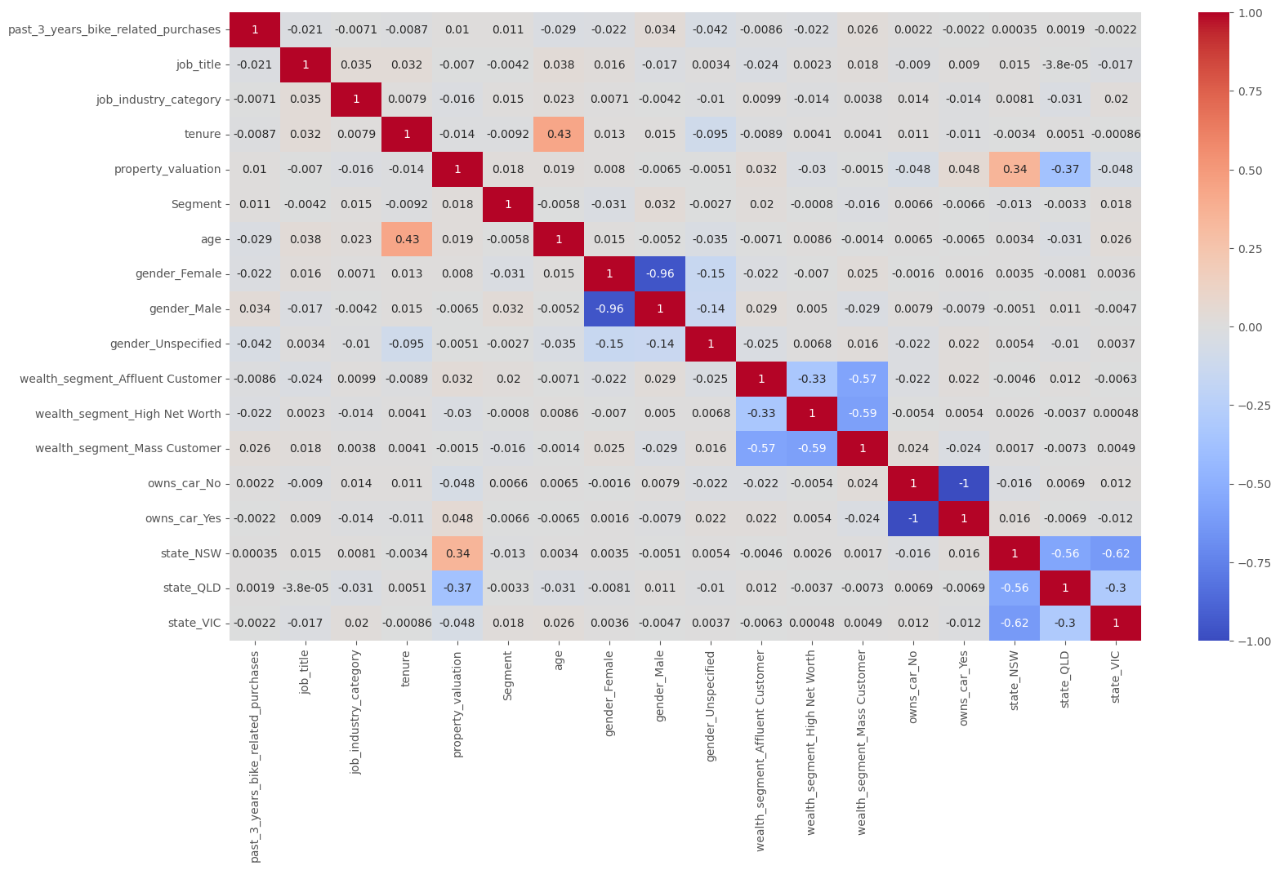
Note: The data and information in this document is reflective of a hypothetical situation and client. This document is to be used for KPMG Virtual Internship purposes only.
Model Development
Random Forest Classifier Model
Using RFM analysis to segment customer.
Model includes 10 features and 1 target variable (gender, past_3_years_bike_related_purchases, job_title, job_industry_category, wealth_segment, owns_car, tenure, state, property_valuation and age)

Slide 8
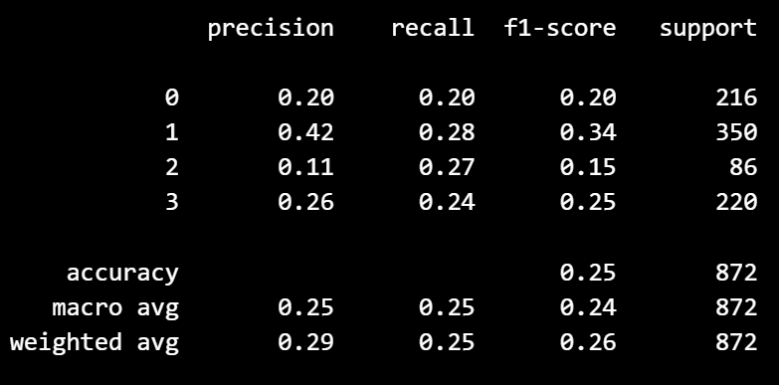
Note: The data and information in this document is reflective of a hypothetical situation and client. This document is to be used for KPMG Virtual Internship purposes only.
Interpretation
Model Evaluation
The model achieves low accuracy with the input variables. Need to improve the model by finding more suitable features and increasing the observations

Slide 9
Note: The data and information in this document is reflective of a hypothetical situation and client. This document is to be used for KPMG Virtual Internship purposes only.
Appendix

Slide 10
Note: The data and information in this document is reflective of a hypothetical situation and client. This document is to be used for KPMG Virtual Internship purposes only.
Appendix
This is an optional slide where you may place any supporting items.

